Slide 1

We are excited to launch ClassDojo across Oak Field to build our classroom community and communicate with you about learning and progress.
Using DoJo, we can build a positive culture where students are engaged and encouraged to love learning!
All parents are invited to be part of our classroom community, sharing in what we’ve been learning each week.

Slide 2
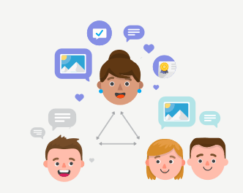
What is ClassDojo?
ClassDojo is a communication app and website for the classroom. It connects teachers, parents, and students who can use it to share photos, videos, and messages during the school day.

Slide 3
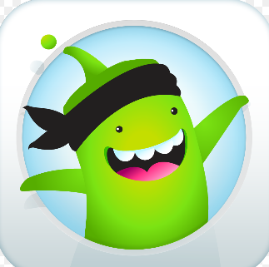
Roll out to whole school
We have trialled this app with Seahorse class and have had great feedback from parents.
With the current situation as it is, we have decided to roll it out to everyone to allow us to stay in contact and share ideas for home learning. Please bear with us whilst we try to get everyone connected.

Slide 4
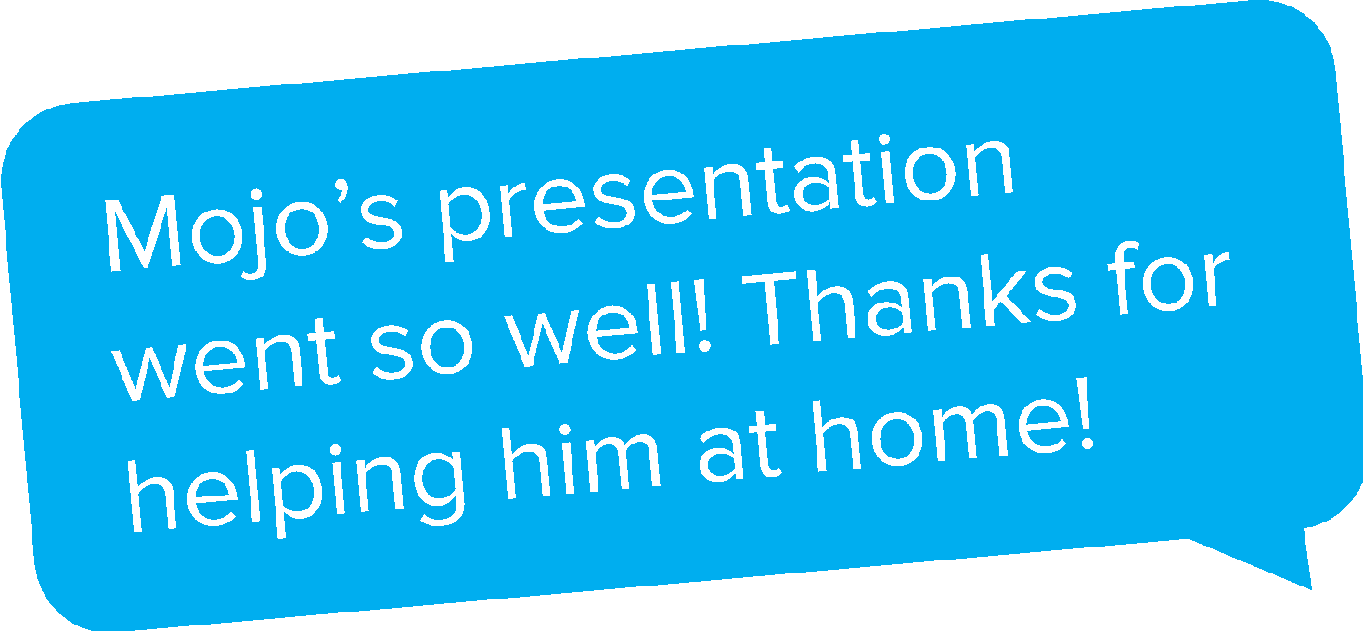

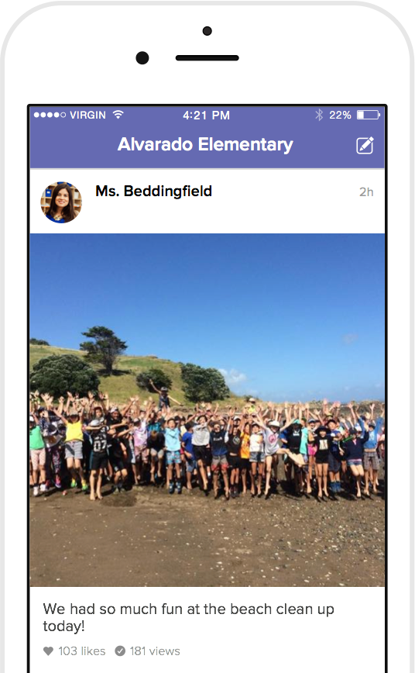
How school will use ClassDojo
As a school, we will:
Post whole school announcements
Share events that the school have taken part in
Upload videos from therapists
Post letters and information that would have usually been sent home in a letter.
As a teacher, I will:
Post class announcements and updates regularly on Class Story
Share photos and videos of our classroom activities
Send private messages to parents to keep you in the loop!

Slide 5
How parents will use ClassDojo
Parents can interact with posts by liking and commenting. Comments should remain about the learning and stay relevant to the original post.
Parents can message their child’s teacher with relevant questions or queries about their child’s learning and progression.
Messages and posts can be translated into over 35 different languages to help all families access the platform.
Class Dojo is fully compliant with GDPR legislation.
By signing up, you are agreeing to the terms and conditions of Dojo, and agree not to share images of any children other than your own on any social media platform or public place. For more information on this please refer to Dojo terms of service and privacy policy.

Slide 6
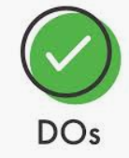

Privacy
All areas will be monitored by the Senior Leadership Team. By signing up to this platform we expect all parents and staff to adhere to the guidance below.
Only make general comments linked to the original post by the staff member. Individual questions linked to your child to be messaged directly to class teacher. Follow GDPR rules. Like as many comments as you wish! Have fun and get involved, we all want to keep in contact! | Mention any other child apart from your own. Export any photos or posts and share them on social media. Share login details with anyone.

Slide 7
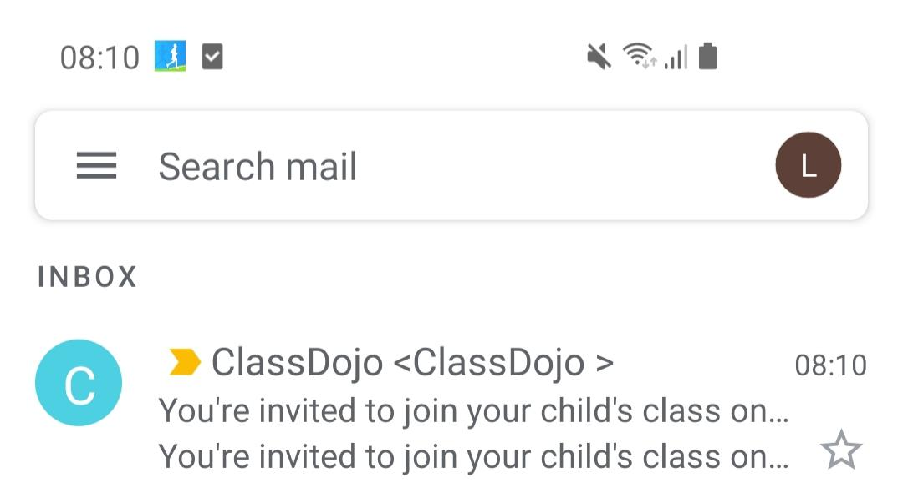
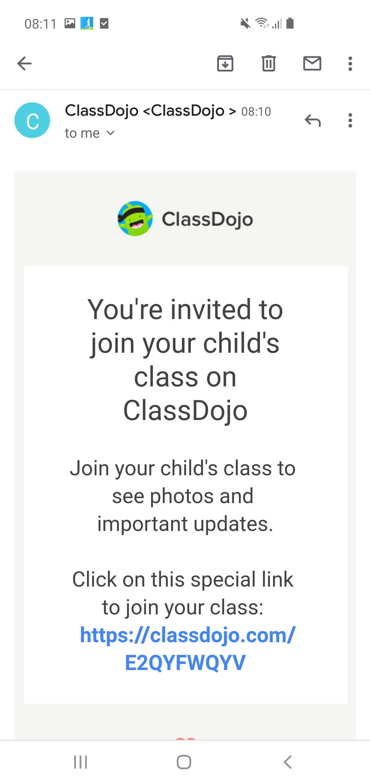
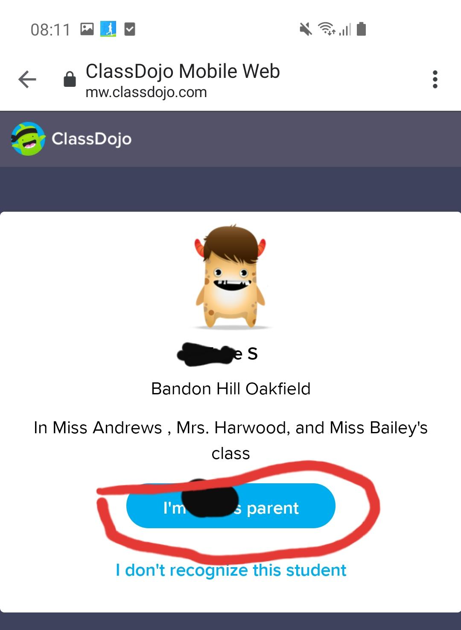
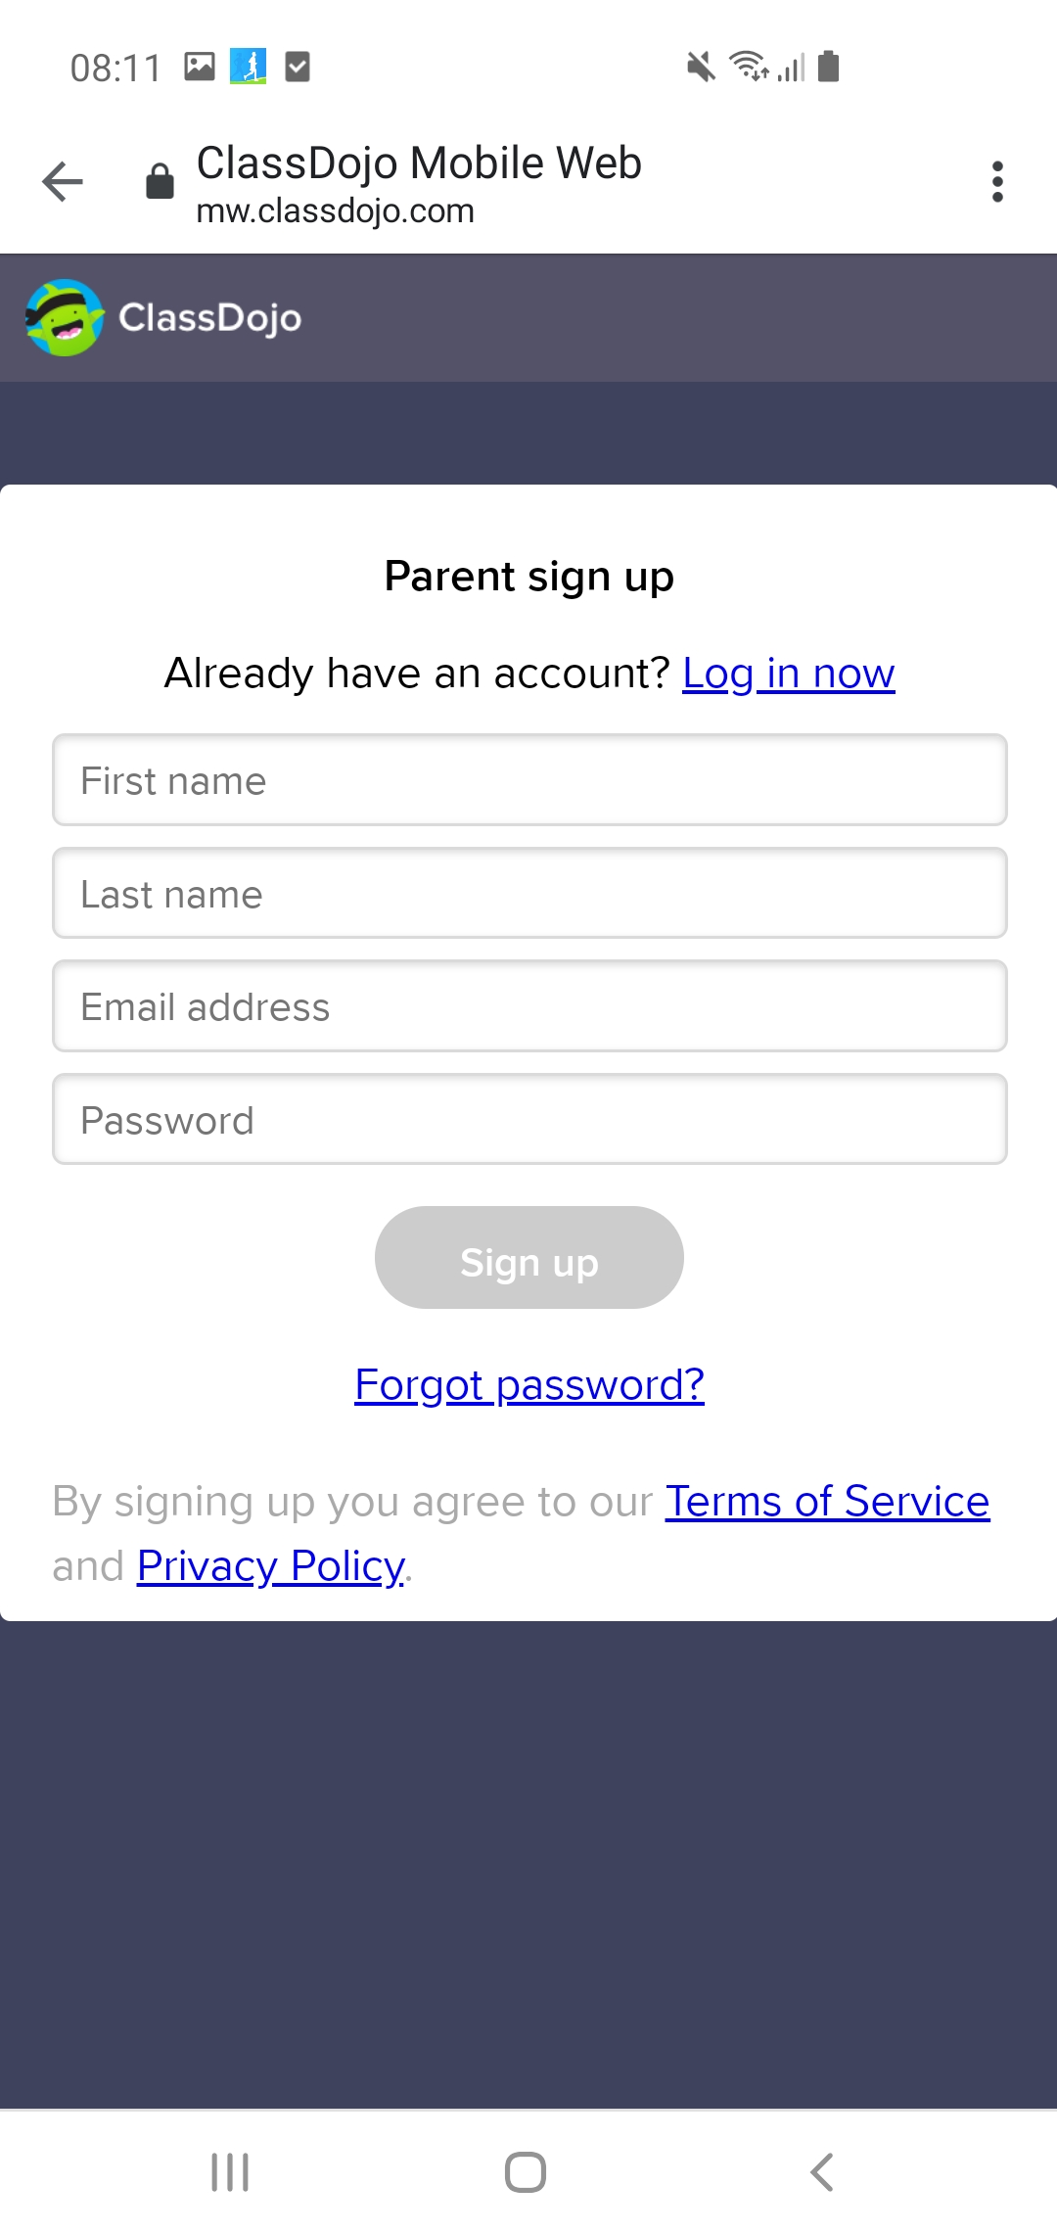

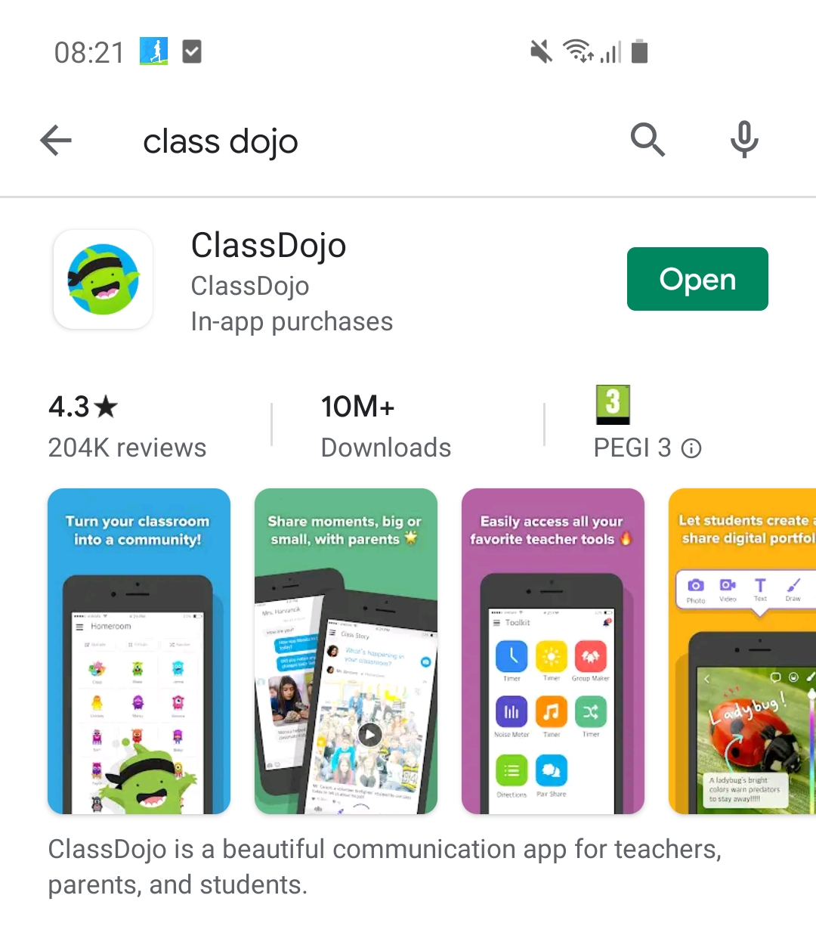
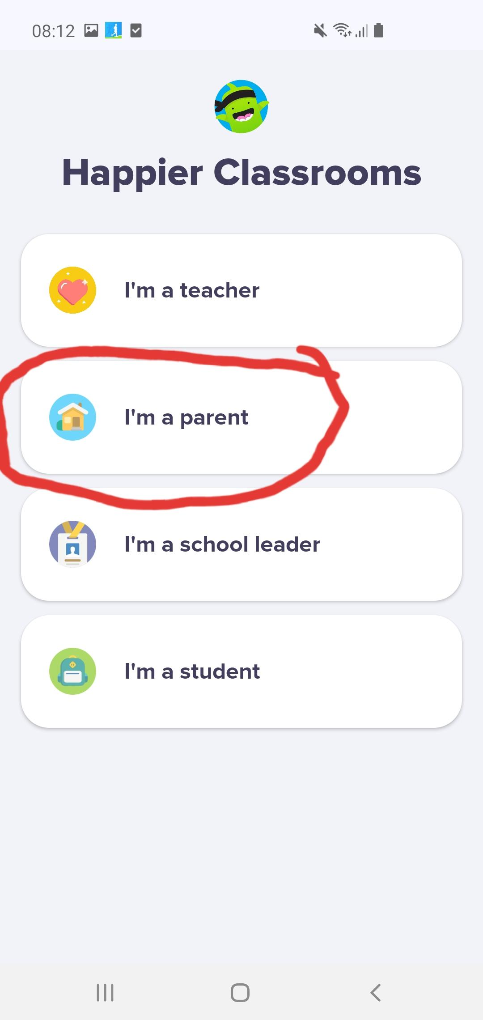
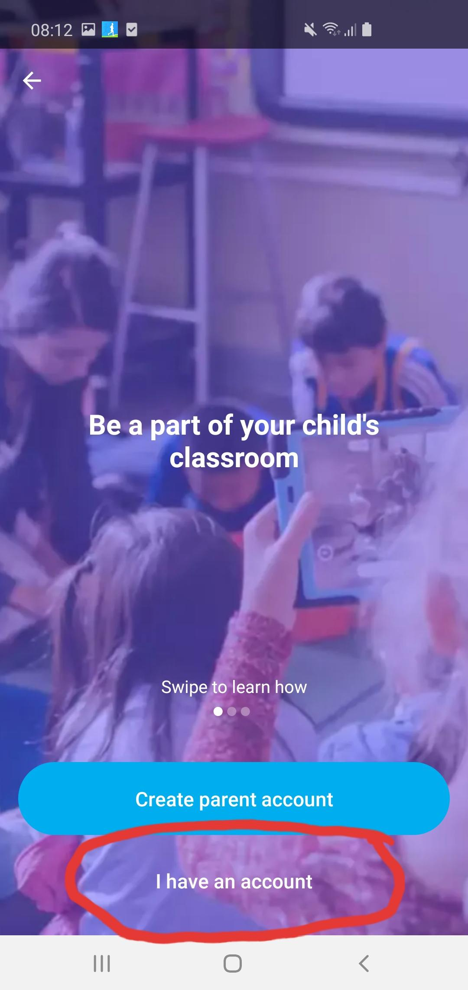
How to connect
3. Check that this is your child and click on ‘I am ….’s parent’
4. Fill in your information and create a password
You will receive an email like this
2. Click the link to create an account
8. Press on ‘I have an account’ and enter the log in details you created in step 4
5. Download the app from your app store
6. Open the app
7. Click ‘I am a parent’

