Slide 1

Welcome to Year 1!

Slide 2

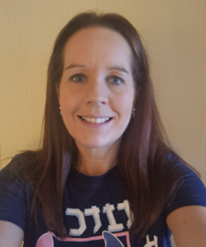
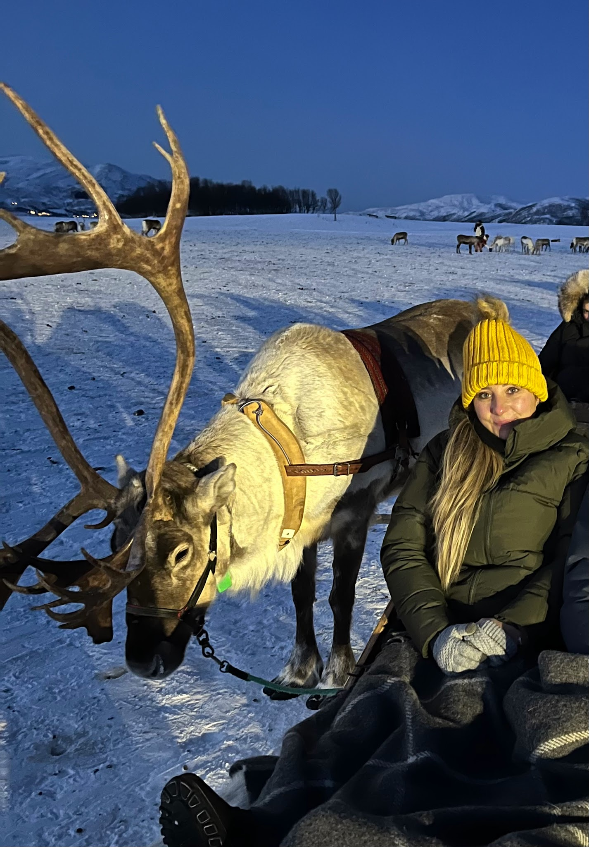
Teachers
Ms Tulip
1T class teacher
(Monday -Thursday_
Mrs Robertson - Friday
Miss Philcox
1P class teacher

Slide 3
Class support
We are introducing a new structure for our Support Staff to provide the best possible targeted support. Rather than being assigned to a single room, our Support Staff will work in specialised teams across the school. This includes a dedicated Phonics Team to boost reading progress, a Core Team to support wider classroom learning, a SEND team to support the provision for our SEND learners and a Social and Emotional team.

Slide 4
Drop off and pick up
The children can arrive at school between 08.35 – 08.45 where they will complete morning work. We encourage children to arrive as early as they can so this learning can be completed and they can settle into their day.
The children will say goodbye in the main playground and enter the double brown doors.
The school gates will open at 3.10pm for collection.
All year 1 classes will be lined up in front of the gym equipment
Please wait for the class teacher to dismiss the children one by one.
If you wish to speak to the class teacher, please wait until all the children have been dismissed and they will happily do so at this point.

Slide 5

Behaviour expectations
In year 1, we use a behaviour chart consisting of five stages.
Everyone starts on the sun everyday, they can reach the rainbow or shooting star through consistent good behaviour or outstanding personal progress.
If a child carries out inappropriate behaviour e.g. consistently talking on the carpet, they will be given a warning and, if the behaviour fails to improve, they will be moved to the white cloud. If the child gets onto the rain cloud, you will be informed by ping or a conversation at the end of the day.

Slide 6
Dojo and praise points.
During Year One, we will continue to use Dojo for photos, messages and reminders.
We will also use Dojo to award Praise Points. Children will receive Praise Points for demonstrating our school’s SMART behaviours, including:
Being kind and helpful
Smart walking
Smart listening
Smart learning
Trying their best
Showing positive attitudes and behaviours
Praise Points will initially be recorded on Dojo. We will then transfer these points to Bromcom, so that you will be able to see and celebrate your child’s achievements and praise with us.

Slide 7
PE days
PE lessons will take place on the following days:
1P – Wednesday and Thursday
1T – Wednesday and Friday
Please remember that PE kits need to be worn to school on these days.
Children should not wear earrings to school on these days unless they can remove them independently.

Slide 8
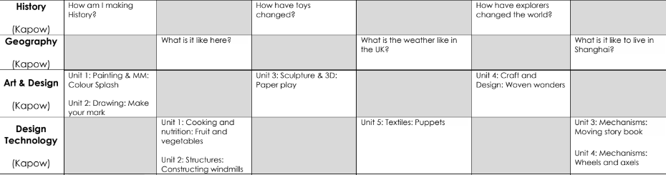
Topics

Slide 9
Trips and workshops
We are currently finalising the details for this year’s upcoming school trips to ensure they offer enriching, safe, and memorable experiences for our students. Full itineraries, dates, and booking information will be confirmed and shared with you as soon as possible.
Thank you for your patience and enthusiasm as we prepare these exciting opportunities!

Slide 10
Year 1 Assessments
Year 1 children will sit their phonics Screening Check in June. They will have daily phonics lessons to learn new sounds and to consolidate and build upon all their learning from reception.
We will be sending out further information about the screening and how to best support your child in the coming weeks and throughout the year.
There will be half termly phonics assessments.
End of year results will be based on teacher assessment – this will be supported by evidence of in class learning as well as informal tests completed throughout the
academic year.

Slide 11
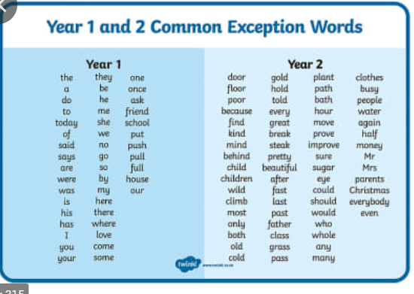
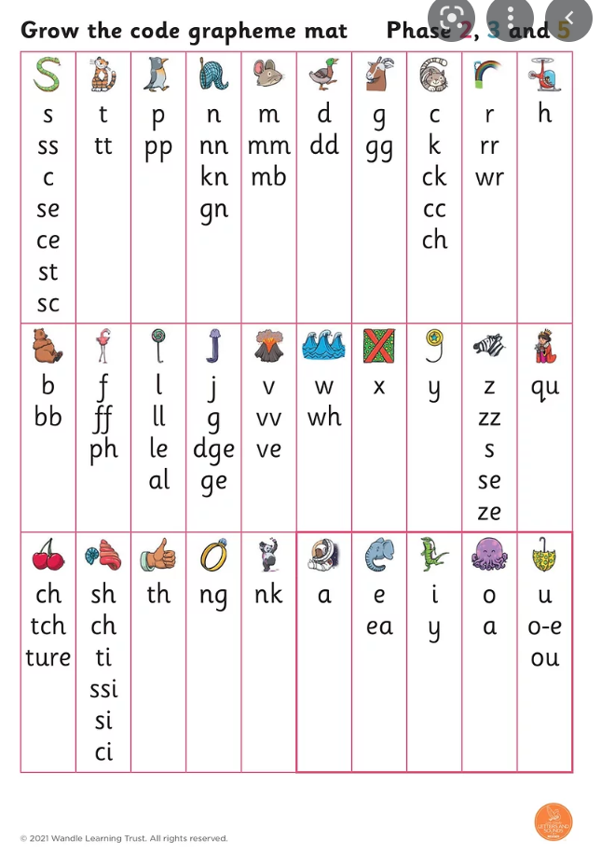

Reading
As in Reception, the children will have reading sessions with an adult following our school scheme, Little Wandle Letters & Sounds.
They will already be familiar with the reading book they bring home on a Wednesday. The aim is the children build up their reading fluency of the book and share this with you at home. By continuing to read this book, this will hugely aid the children’s reading fluency.
Reading books must be returned on Monday mornings. These are needed throughout the week. If reading books are not returned then we are unable to send a new one home.
The children will visit the library and this will encourage the children to choose books independently and we hope to develop a love for reading.
Library days
1T- Monday
1P- Thursday
This reading needs to be logged in their reading record book. These will be sent home in the first few weeks of the term with your child’s reading book.

Slide 12
Support at home
This power point will be sent out (as soon as possible)
There are lots of simple and enjoyable ways you can support your child’s learning at home, and reading together is one of the best things you can do!
We encourage you to read to your child as often as possible and to enjoy a range of different books together. It is also really helpful to hear your child read regularly. This could be their school reading book or a book they have chosen themselves — the most important thing is that they enjoy reading and have plenty of opportunities to practise.
You can also support your child by practising the sounds, words and tricky words they have been learning in phonics. Their phonics sounds and words will be added to their reading record each half term, giving you an easy way to see what they are learning and practise these together at home.
If you are looking for some extra fun ways to practise phonics, there are lots of fantastic resources available online, including:
Phonics Play
Phonics Bloom
Topmarks
YouTube, including the popular Geraldine the Giraffe videos
Please don't feel that learning at home needs to be formal — sharing a story, spotting sounds in the environment, practising tricky words or playing a phonics game together can all make a big difference.
Most importantly, we want children to develop a love of reading and learning, so please keep it fun, positive and full of praise! 🌟

Slide 13
Please use this email to communicate: office@woodfieldprimary.com
Teachers are also available for an informal discussion after school, once the children have been dismissed.

Slide 14
Reminders
The children do not need their own pencil cases as we have plenty of stationary for the children to use in class.
Please ensure that EVERYTHING brought into school is named.
Children to have a water bottle in school each day.
The children continue to be provided with a free fruit snack each day.

